Slide 1
Music Player based on Age Classification
Group ID - 03
Presented by-
1414089 Giten Kadam
1414099 Heet Navsariwala
1414103 Keya Mankar
Guide- Prof. Sujata Pathak

Slide 2
Outline
▶Problem Definition
▶Literature Survey
▶Functional and non-functional requirements
▶Technologies used
▶Time line chart with responsibilities
▶Block Diagram
▶Software Design Documents
▶Test Cases
▶Application and Future scope
▶References

Slide 3
Problem Definition
Music Player based on Age Classification can classify the age of the user by an image of the user’s face and play music that adheres to the user’s taste in music.
It aims to decrease the manual labor involved in creating playlists of music from different eras.
This will help the user to listen to good music with no major manual labor.

Slide 4
Literature Survey
Sarita Jain, Dr. A.J.Patil, “Human Age Prediction from Facial Images”.
This paper presents an algorithm to predict human age from facial images using facial features and edge detection.
2. Zainab A. Othman, Dina A. Adnan, ”Age Classification from Facial Images System”.
This paper presents a system which classifies image into one of 4 age groups. It uses Primary Face features i.e the six ratios and Secondary Face features which consists of wrinkle features.

Slide 5
Functional and Non-Functional Requirements
SRS
Non-Functional Requirements:
The load time should be less than 15-20 seconds.
Error message should be displayed as early as possible.
The system shall consume very little of primary memory and should not affect system performance.
Functional Requirements:
Predict User Age.
Recommend a playlist based on user’s age.
Play the songs from the recommended playlist.

Slide 6
Technologies Used
MATLAB
GUIDE
Computer Vision Toolbox
Webcam

Slide 7
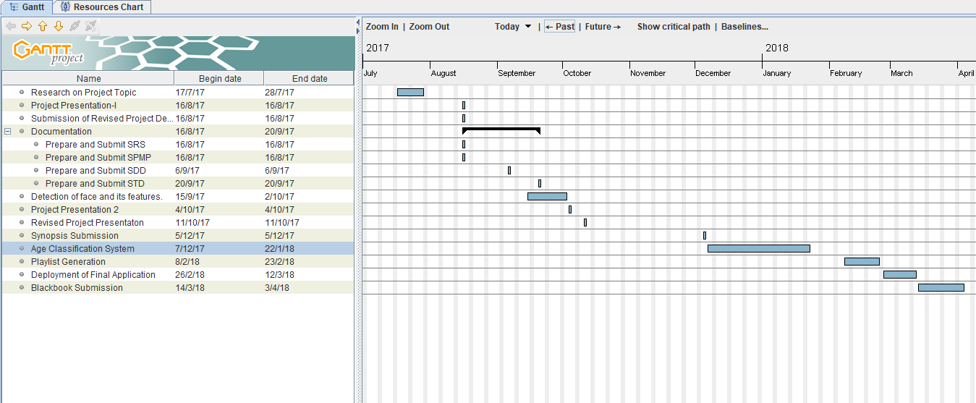
Timeline Chart and Responsibilities
SPMP
Gantt Chart:

Slide 8
Roles and Responsibilities
Name | Role | Responsibility
Giten Kadam | Project Team Member | Documentation, Implementation, Requirement Gathering, System Design.
Heet Navsariwala | Project Team Leader | Documentation, Implementation, Requirement Gathering, System Design.
Keya Mankar | Project Team Member | Documentation, Literature Survey, Requirement Gathering, System Design.

Slide 9
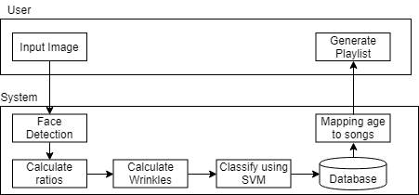
Block Diagram

Slide 10
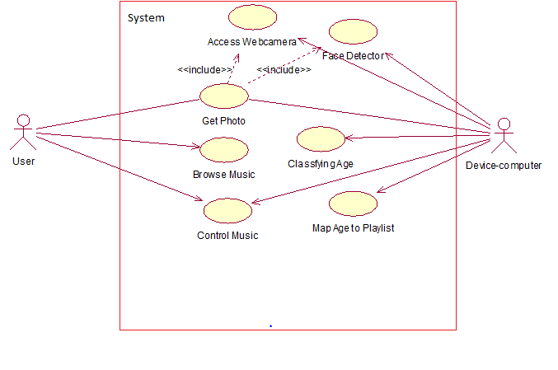
Software Design Document(SDD)
SDD
Use Case Diagram:

Slide 11
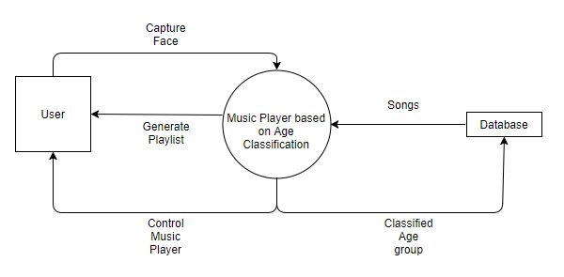
Software Design Document(SDD)
Data Flow Diagram Level 0:

Slide 12
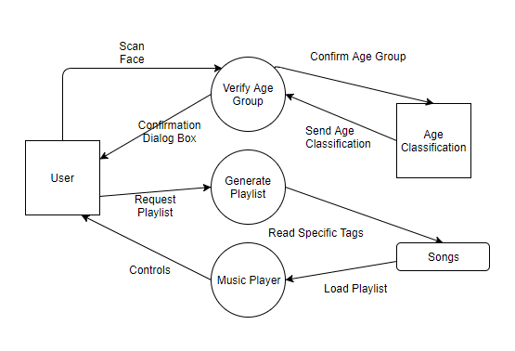
Software Design Document(SDD)
Data Flow Diagram Level 1:

Slide 13
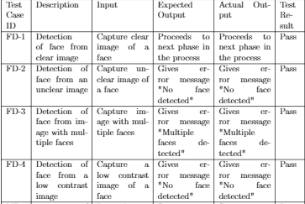
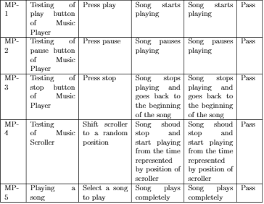
Test Cases
STD
Face Detection
Music Player

Slide 14
Application and Future Scope
The system created can be integrated with face authorization system to save a user's preferences and can also be coupled with a mood detection system to further refine the objective of playlist generation.
At present the system is an executable application which can only run on a desktop, but in future it can also be modified to work as a web application or a smartphone application.

Slide 15
References
Zainab A. Othman, Dina A. Adnan, ”Age Classification from Facial Images System”, International Journal of Computer Science and Mobile Computing(IJCSMC),Volume 3, 3, Issue. 10, October 2014.
Sarita Jain, Dr. A.J.Patil, “Human Age Prediction from Facial Images”, International Journal of Innovative Research in Computer and Communication Engineering, Volume 4, Issue 7, July 2016.
Labeler, I. (2017), “Detect objects using the Viola-Jones algorithm - MATLAB - MathWorks United Kingdom. [online] In.mathworks.com” Available at: https://in.mathworks.com/help/vision/ref/vision.cascadeobjectdetector-system-object.html.
Young H. Kwon and Niels da Vitoria Lobo,”Age Classification from Facial Images”, Computer Vision and Image Understanding Vol.47, No.1,April,pp.1-21 .1999.
W. B. Horng, C. P. Lee, C. W. Chen., “Classification of age groups based on facial features”,Tam kang Journal of Science and Engineering, vol. 4, pp. 183–192, (2001).
MATLAB (Version 9.2.0.556344-R2017a).

Slide 16
Thank You!

